Slide 1
Sales Performance Analysis
Mirko Laine

Slide 2
Agenda
Executive summary
Dashboard overview
Product analysis
Manager & Region insights
Descriptive analysis
Box & Whisker plot
Conclusion

Slide 3






Executive Summary
Key Metric | Units
Total Revenue | 812 135€
Best Selling Manager | Joao Silva – 283 555€
Best Revenue Generator Product | Burgers – 392 000€
Best Selling Product | Beverages – 35 666 units
Overall Sales Volume | 118 539 units sold across all products
Dominant Payment Method | Credit Card – Used in 49.72% of transactions

Slide 4
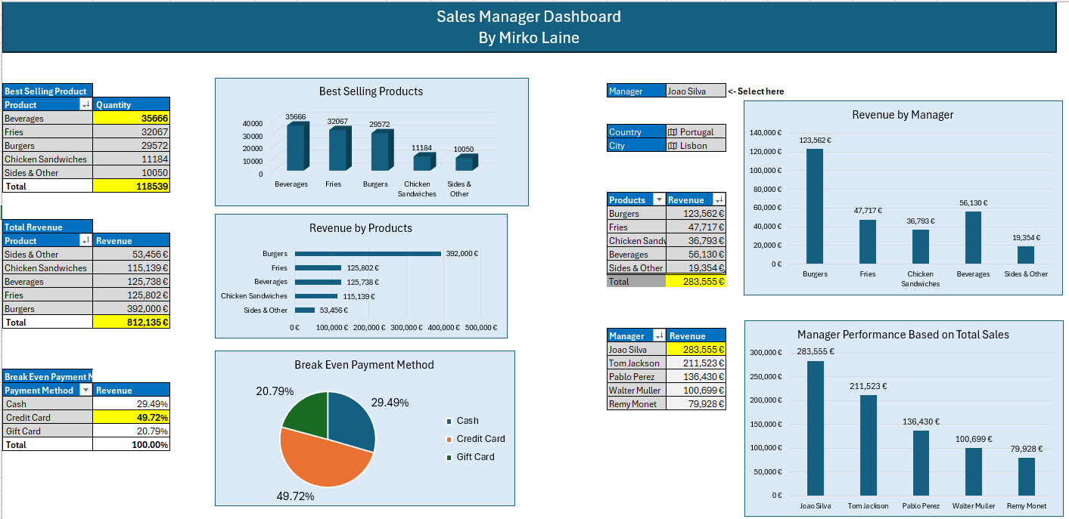
Dashboard Overview
Burgers Generate the highest revenue – Totaling 392 000€
Beverages are the best-selling product – 35 666 units sold
Credit Card is the top payment method – used in 49.72% of all transactions
Portugal, Lisbon ranks as the most profitable location for manager Joao Silva

Slide 5
Product Analysis
Key Insights:
Volume does not equal value:
While beverages lead in units sold (35 666 units), burgers drive significantly more revenue (392 000€), making them the top contributor to total sales.
High-margin products stand out despite lower volume:
Chicken sandwiches generate 115 139€ revenue with just 11 184 units sold, highlighting a strong average price and solid margin.
Fries outperform in volume, underperform in revenue:
With over 32 000 units sold, fries rank second in quantity but fall behind in revenue (125 802€), suggesting possible price sensitivity or lower unit value.
Diversification opportunity in “Sides & Other”:
Despite modest volumes (10 050 units) and lowers product-line revenue (53 456€), this category represents a potential are for targeted upsell or bundling strategies.

Slide 6
Product Analysis cont.
Strategic implication:
The business should prioritize revenue efficiency, not just unit movement. Expanding focus on high-price, high-margin items like burgers and chicken sandwiches could maximize profitability. Simultaneously, evaluating pricing or bundling strategies for high-volume, low-revenue items (fires, sides) may unlock further grow.

Slide 7
Sales Performance by Manager and Region
Key Insights:
Joao Silva is the top-performing manager, generating 283 555€ in total sales, which is nearby double the next highest performer.
Pablo Perez leads the Spanish market with 136 430€ in revenue, locating in Madrid. His performance accounts for a strong share of local revenue.
Regional leaderboards show opportunity gaps:
Tom Jackson dominates the UK market with 211 523€.
Remy Monet and Walter Muller trail behind with 79 928€ and 100 699€ respectively, indicating potential for targeted support or strategic repositioning.

Slide 8
Sales Performance by Manager and Region
Strategic implication:
Top performers like Joao Silva and Pablo Perez are driving a significant share of total revenue.
Consider replicating their sales practices, product focus, or customer engagement strategies in lower-performing regions. City-level targeting could enhance localized performance in underperforming markets.

Slide 9
Descriptive Analysis – Price
Key Metrics:
Mean price: 7,27€
Median price: 4.99€
Minimum: 2.95€
Maximum: 33.22€
Standard deviation: 4.85€
Sample size: 262 transactions
Key Insights:
Large price spread: From 2.95€ to 33.22€ indicating a mix of low-cost items (e.g., fries, beverages) and premium options (e.g., burgers).
Right-skewed distribtion: Meand (7.27€) is noticeably higher than the median (4.99€), suggesting the presence of high-priced outliers.
Moderate price volatility: A standard deviation of 4.85€ implies a wide variety in product pricing across categories.

Slide 10
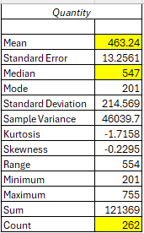
Descriptive Analysis – Quantity
Key Metrics:
Mean Quantity (Units/Order): 463
Median: 547
Minimun: 201
Maximum: 755
Standard deviation: 214.57
Sample size: 262 orders
Key Insights:
High variability in order size: With a wide range of 554 units (min201,max 755), sales quantities vary significantly by product or transaction.
Left-skewed distribution: The median (547) is higher than the mean (463), indicating more smaller-sized orders pulling the average down.
Bulk sales opportunities: High maximum values suggest that some product categories (likely beverages or gift-card promotions) move in bulk.

Slide 11
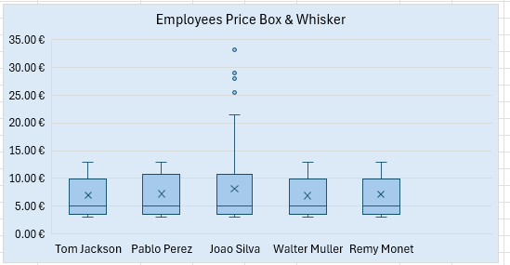
Box & Whisker
This box & whisker plot visualizes the distribution of product prices handled by each sales manager. It highlights:
Median prices
Price ranges (interquartile spread)
Outliers (extreme high/low-priced transactions)

Slide 12
Box & Whisker cont.
Key Insights:
Joao Silva stands out with the widest price range and multiple high-value outliers.
His pricing spread extends above €30, indicating sales of premium or high-ticket items (e.g., burgers with extras or high-value bundles).
Suggests flexibility in pricing or access to higher-tier customers.
Tom Jackson, Pablo Perez, Walter Muller, and Remy Monet show more consistent and tighter pricing ranges.
Their price bands are mostly between €3 and €13, with fewer outliers.
Reflects standardized pricing or product focus on core, lower-to-mid-tier items (e.g., fries, beverages, sandwiches).
Pablo Perez and Walter Muller have similar median prices (~€7–€9), indicating consistent mid-range sales strategy in their regions.
Strategic Implications:
Joao Silva may be operating in a market or customer segment with higher price elasticity or premium offerings. His approach could be studied for upsell strategies or replicated in other regions to boost average transaction value. Meanwhile, consistency from other managers supports operational control — but could also signal missed upsell opportunities.

Slide 13

Interpreting Joao Silva’s Outliers: Good or Concerning?
Reasons it could be good (opportunity-driven):
High-ticket sales = more revenue per transaction Joao’s wide range and high outliers may reflect successful upselling, bundle deals, or sales of premium products.
Market-specific conditions He might be selling in a region (e.g., Lisbon) where consumers are willing to pay more — localized pricing could be strategic, not accidental.
Targeting different customer segments Joao might be reaching corporate or bulk buyers, who purchase large orders at higher prices — a sign of strong relationship management.
But it could also be a risk (inconsistency-driven):
Lack of pricing discipline Too many outliers might indicate inconsistency or lack of adherence to standard pricing policy — hurting brand trust or fairness.
Customer dissatisfaction risk If two customers buy the same product at very different prices, it may lead to negative word of mouth or complaints.
Data entry or system issues Outliers can sometimes reflect errors (e.g., decimal typos — €299 instead of €2.99), which can inflate reporting inaccurately.
Investigate, not penalize. → Joao’s performance is strong — €283,555 in revenue — so his outliers might represent innovation, not misconduct. But it’s wise to:
Audit a sample of his high-priced orders
Check if products sold match intended pricing tiers
Understand whether this variance aligns with business strategy

Slide 14
Conclusion
Key Takeaways
Revenue leadership is not volume-driven: While beverages lead in unit sales, burgers deliver the highest revenue, underscoring the importance of focusing on high-margin products.
Top performers drive disproportionate impact: Joao Silva and Pablo Perez account for a significant share of total sales, with Joao’s pricing flexibility offering both opportunity and risk.
Price dispersion signals varied customer targeting: Joao’s wide price range suggests potential for premium sales strategies, while other managers reflect tighter, more standardized pricing.
Descriptive analytics reveals growth levers: High variability in order size and product pricing supports the case for tailored pricing, bundling, and segmentation strategies.
Strategic Recommendations
Double down on premium and high-margin categories Prioritize burgers and chicken sandwiches in marketing, menu design, and sales incentives.
Replicate high-performing manager practices Analyze Joao Silva’s and Pablo Perez’s tactics — apply learnings in lower-performing regions (e.g., Germany, France).
Investigate and refine pricing strategy Audit high-priced transactions for consistency and intentionality. Consider implementing guardrails or dynamic pricing models.
Leverage data to enable regional customization Deploy city- and manager-level dashboards to empower local decision-making with real-time insights.
Next Steps
Conduct a pricing audit on high outliers to validate integrity.
Launch a pilot upsell strategy using Joao Silva’s sales structure.
Build tailored sales playbooks for underperforming regions.
Integrate sales manager KPIs into ongoing dashboard reporting.

Slide 15
Thank You!

